Slide 1
Bringing Zoom to Life
Kara M. Brostron, CLM
Sharon Stewart
Rita Garrett
Cheri Newey

Slide 2
Scavenger Hunt
VIRTUAL SCAVENGER HUNT
I will give you an item and you have to go find it. Scoring will be based on the order you bring back the item and show it on screen.
You’ll have one minute to find each item to keep the hunt moving. If you know for certain you don’t have something, just let me know you are out of that round.
You can’t take the phone or computer you’re using with you.
No using phones for answers (i.e., you can’t look up a picture of a Tom Hanks movie on your phone).
An item cannot be used for two different answers (e.g., Toy Story movie couldn’t be used for Tom Hanks movie + Disney character)
SCORING: FIRST, SECOND, LAST
The first person to come back gets five points, the second person to come back with their item gets three points, and anyone else who comes back with the item within the minute gets one point. I highly recommend having a scorecard that is visible to the entire group at all times – maybe setup a separate screen or something so people can see it. Or if you don’t do a visible one, at least do a check-in every five or so items so people know where they stand.

Slide 3
ZOOM Tips and Tricks
Many options in the settings for Zoom
Share screen - Audio
White Board
Polling
Breakout Rooms – split chapter into teams
Templates
Reports – Account Management
Questions?

Slide 4
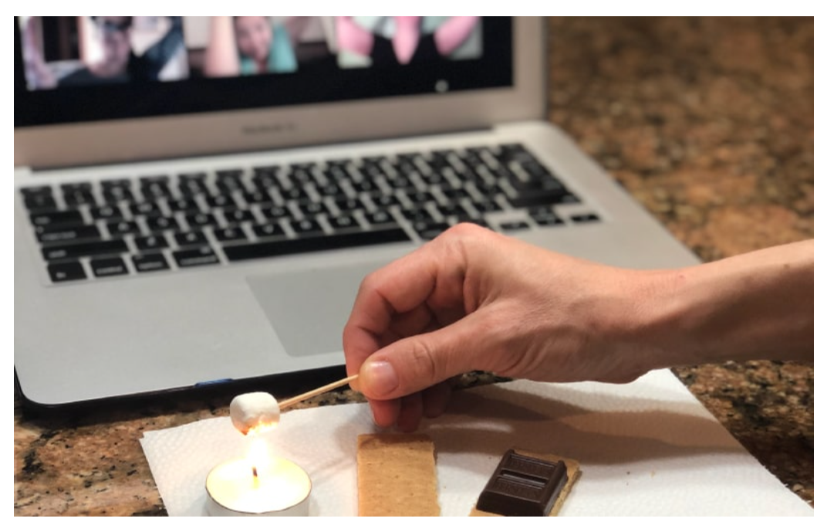
Virtual Teambuilding Ideas
Escape Room – use breakout rooms
Sip & Paint Party – ex: Pinot’s Palette, etc.
Pictionary
Lip Sync Battle
Solve A Murder Mystery – I am innocent app
Scattergories – scatteriesonline.net
Show and Tell Show
Tiny campfire
tiny campfire runs virtual campfires for remote teams. The experience includes haunted historic ghost stories, icebreakers, little competitions and even a real s’more making experience. It’s fun, wildly smart, and probably the best damn online camping experience in the world. No mosquito repellent needed.
Received general quote for $600 for min. 10 people, $60 each add’l person.

Slide 5
Virtual Teambuilding Ideas
Best Origami Zoom Competition
https://www.instructables.com/id/Origami-For-Everyone/
Virtual Pub Crawl
Join a virtual meeting or conference call with your team members.
Everyone goes to an interesting website (think Business Partners?), and chats about the content over a drink.
Every 15 minutes, move to a new website.
Improv – That’s Right Bob
The first person to go shares a simple news story with no more than a sentence or two, “there was a cat up in the tree.” The next person states, “that’s right Rob”, repeats the original line and then adds to it, “there was a cat up in the tree, and it was having a very bad day.” Each person continues to add to the story in this way, until the story becomes unbearably long or the organizer calls for a commercial break.
That’s Right Bob is a unique way to engage your team, and helps people speak and share in a creative way that has structure and predictability to it. This format is also one of the easiest for games you can play virtually because it is sequential and has simple guidelines.

Slide 6
Virtual Teambuilding Ideas
Werewolf
A game played at summer camps, or in college. Werewolf is a game of wits, deceit, and skillful manipulation as you seek to survive the night. The entire game is based on speaking, careful listening and voting.
https://www.instructables.com/id/Play-Werewolf/
Virtual Feud (Family Feud)
Check Museums for Virtual Tours
Tiktok Challenges
NetFlix Party – watch movies together with your team
Karaoke – www.singsnap.com
Crossword Puzzles – www.boatloadpuzzles.com
3 Minutes of Push-ups
Headbands
Cooking Class

Slide 7
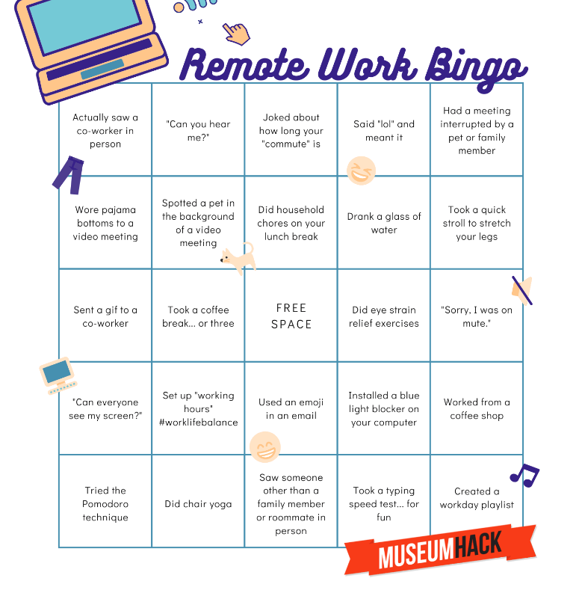
Bingo
Pandemic Bingo game – www.bingobaker.com

Slide 8
Trivia Ideas
Trivia games - www.Sporcle.com or www.kahoot.com (personal has 6 players, business is $500 fee)
Trivia Makers – www.triviamaker.com and www.polleverywhere.com

Slide 9
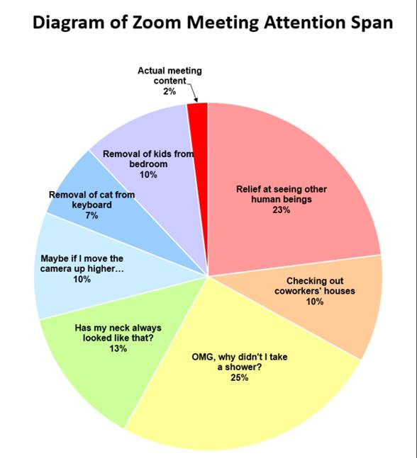

Slide 10
Other Ideas? Questions?

