Slide 1
ALA Member Demographics
ALA Association Leadership Institute
March 16, 2024

Slide 2
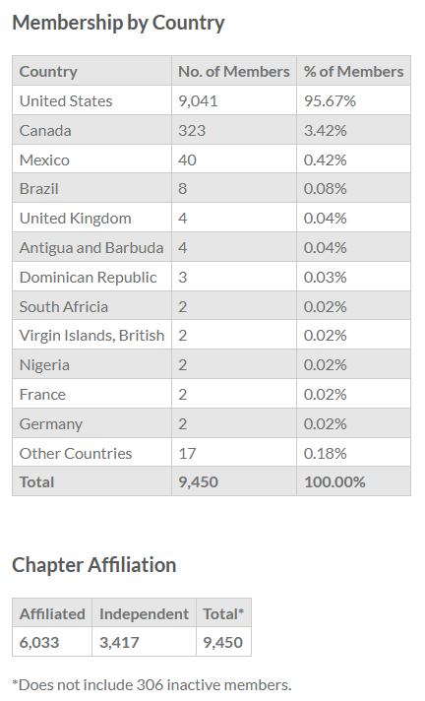
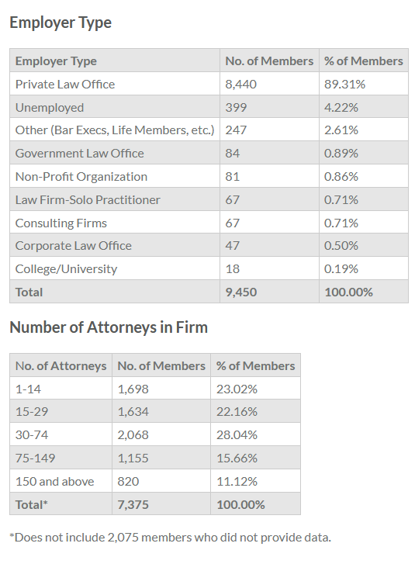
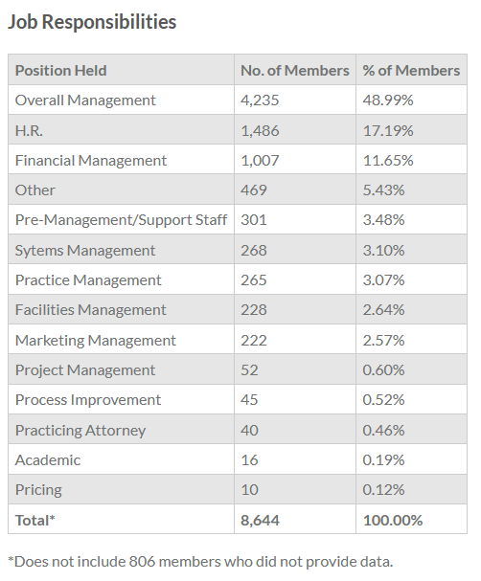
ALA Member Demographics as of 1/1/2024

Slide 3
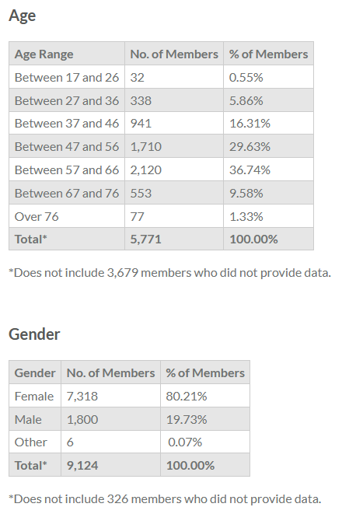
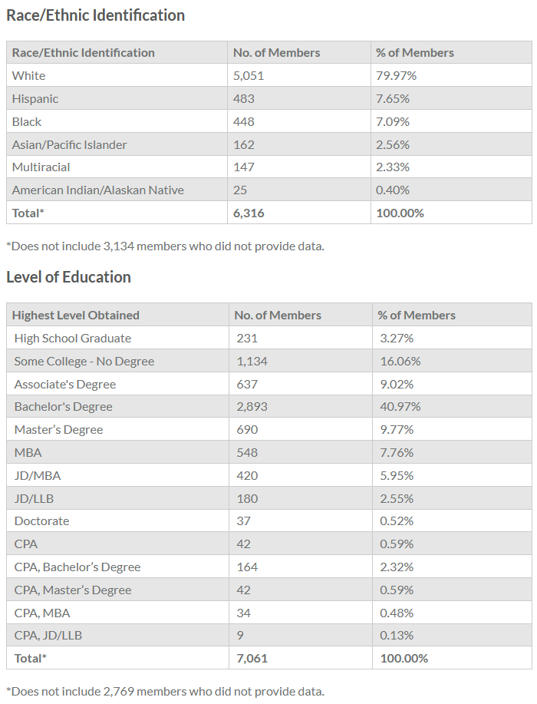
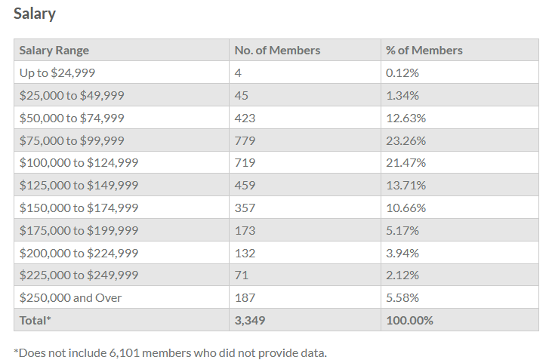
ALA Member Demographics as of 1/1/2024
Notes:
DEIA TACTICS:
DETERMINE CATEGORIES AND FORMAT FOR HOW MEMBER DATA IS REPORTED
ESTABLISH METRICS FOR MEASURING DEIA EFFORTS
UNDERSTAND WHO WE ARE AS AN ORGANIZATION TO MAKE SPECIFIC DECISIONS

Slide 4
ALA Online Community
ALA Association Leadership Institute
March 16, 2024

Slide 5
Online Community: Where are we now?
ALA Members visit the Online Community most frequently to:
Discuss best practices
Share resources
Support one another in both general and special interest topic groups

Slide 6
User Activity: Last 12 Months
1,831 users submitted a post or comment
72.5% Chapter Members
27.5% Independent Members
4,128 total posts
9,822 total comments

Slide 7
Most Active Communities: Last 12 Months (Posts + Comments)
1) General Topics
2) Human Resources
3) Small Law Firm
4) Chapter: Chicago
5) Board of Directors

Slide 8
Benefits of an active Chapter Online Community
Centralize communication
Promote Chapter benefits and programs
Allow members unable to attend in-person events to interact with other chapter members

Slide 9
All Chapters have the option to establish an Online Community!
58 Chapters have an Online Community
26 Chapter Communities with at least 10 posts in the past 12 months
New Online Communities can be proposed to ALA Headquarters with:
Purpose of the new group
Two moderators identified
A plan to share content in the community: type, frequency, topics
Targeted launch date
Timeframe for long the group will exist

Slide 10
Most Online Community Posts: Last 12 Months
ALA Staff Member
ALA Staff Member
ALA Board Member
FALA Board Member

Slide 11
Most Online Community Comments: Last 12 Months
ALA Member (non volunteer)
ALA Member (non volunteer)
ALA Member (Online Community Moderator)
ALA Member (non volunteer)

Slide 12
Member Engagement and the Online Community
Average posts + comments last 12 months:
Renewed for 2024: 2.28
Not yet Renewed: .64
The quickest way to increase our overall member engagement is to increase visibility of relevant Online Community posts and encourage participation

Slide 13
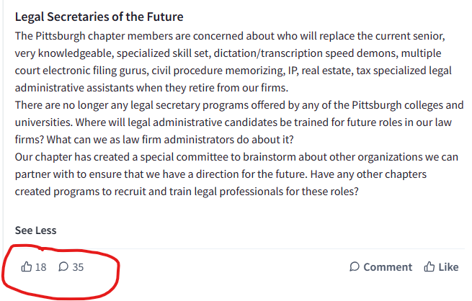
How do we do that?
Share relevant posts with members in real time!

Slide 14
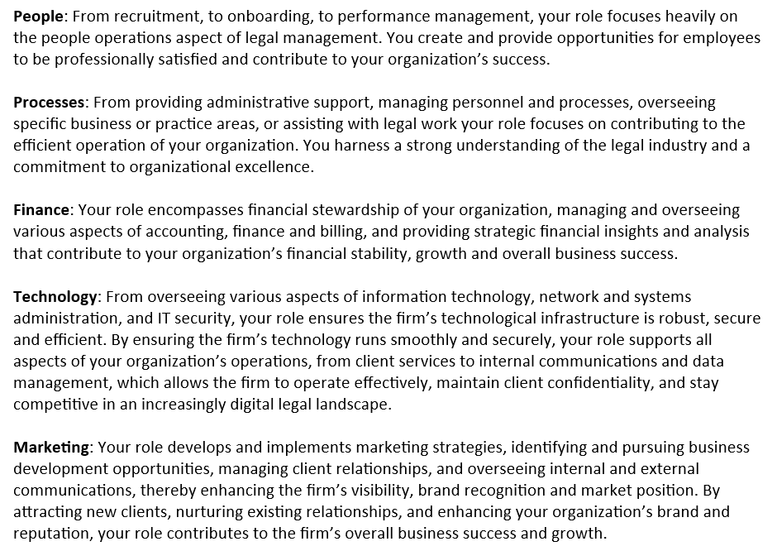
ALA Member Segments

Slide 15
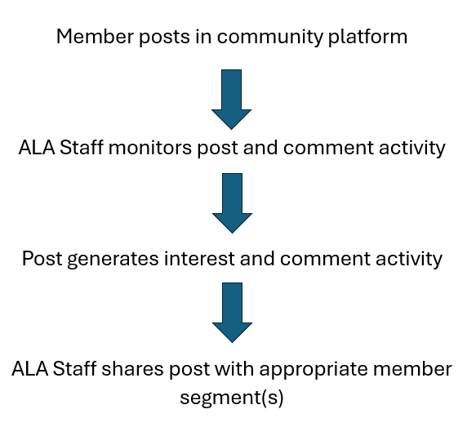

Slide 16
How can I help?
Place yourself in one or more member segments – see what fellow members see!
See an interesting post? Send it our way! membership@alanet.org
Comment where you can – activity encourages more activity

