Slide 2
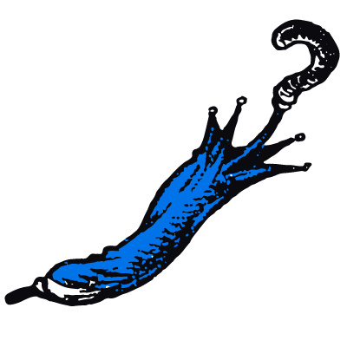
Protecting ALA’s Identity
Notes:
Today you are ALA, that is truer than true. There is no one alive who is ALA-er than You.

Slide 3
You know what goes best
with green eggs and ham?
A cohesive image and identity
—they are the jam.

Slide 4
Simple Rules to Follow
Our logo is the center of our brand.
Use it correctly to reinforce its legal protection as our identity.
Apply these standards and guidelines in all materials to ensure maximum consistency and visibility with every brand touchpoint.
bit.ly/3ViLMgO
Notes:
ALA established Identity Standard Guidelines that can answer questions on the correct usage of the Association logo and colors, how ALA’s name should appear on general correspondence and related identity issues. https://bit.ly/3ViLMgO
From CLMs to MBAs, SHRM-CPs, CPAs, JDs, and more … your credentials define where you’ve been, what you’ve done and what’s at your core. Your name is everything, and so is ours. It’s our lifeblood, what drives us, what empowers. We have rules for when to use ALA and how, so mind these rules in a month, a week, a day and now.
These are from our style guide to which we stay true. Here are some rules that I will share with you.

Slide 5
Our Name
The Association of Legal Administrators (or any form of the name) is a singular noun and requires a singular verb.
On first reference, spell out the entire name: Association of Legal Administrators (ALA). Use acronym on all further references in the document.
Capitalize “The” before the Association name only if it appears at the beginning of a sentence.
If you prefer to use “the Association” on second and succeeding references to ALA, it should be capitalized.

Slide 6
ALA Board of Directors and Officer Titles
Capitalize titles in all specific reference to ALA leaders.
Board of Directors: All references to the ALA Board (with or without the modifying ALA preceding it) should be capitalized: ALA’s Board of Directors meets each July. At that meeting, the Board finalizes its goals for the year.

Slide 7
Other Names to Note
Business Partners
Never use vendor
Never use BP
Chapter Resource Team
CRT on second reference
Foundation of the Association of Legal Administrators
Always write out in full — no FALA.
Second reference: the Foundation

Slide 8
Chapters
Lowercase “chapter” in generic references: All chapters are encouraged to send members to the ALA Educational Conference.
Capitalize “chapter” in any reference to a specific ALA entity: The Golden Gate Chapter always participates in the Chapter Awards Program. The chapter won awards in many categories.
Always try to use the FULL official names of chapters in written references (exe. Wisconsin Association of Legal Administrators (WALA), unless you are in the state or city of the chapter: It’s great to be visiting the Wisconsin Chapter again.
·

Slide 9
License agreements always read dry, but they have a purpose and I’ll tell you why.
Notes:
An effective licensing agreement is the most effective solution for protecting your intellectual property. A licensing agreement allows owners of intellectual property to authorize third parties to use, alter, or resell the property for a mutually agreed-upon price, without transferring ownership to the third party.

Slide 10
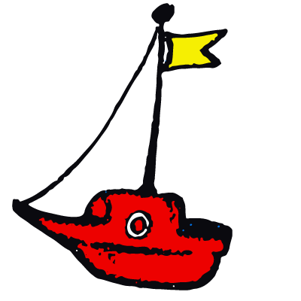
Registered trademarks, I’ve seen a few. If you are a CLM, this one’s for you.

Slide 11
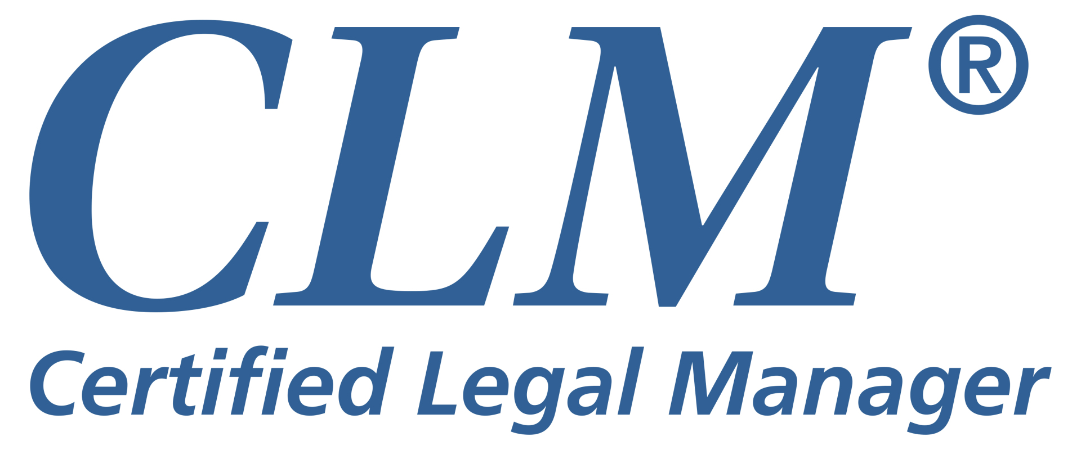
Certified Legal Manager (CLM)®
Must be portrayed in a clear and consistent manner.
On the first reference, spell out the entire official name of the program, followed by the letters (CLM) in parentheses, the superscripted registration mark and an asterisk: Certified Legal Manager (CLM)®*
In small type at the bottom of the page, you must then footnote:*CLM is a registered mark of the Association of Legal Administrators.
Notes:
CLM is a registered certification mark. The guidelines for using the letters “CLM” are similar to the guidelines we use when we refer to our Association. On first reference, we spell out the entire name, followed by the initials in parentheses: Certified Legal Manager (CLM)®. From then on, it can read CLM.
This holds true for the Certification Program as well; however, please be sure to use the registration mark, too. The first time the letters CLM are used, in combination with the words “Certified Legal Manager” or otherwise, they must be followed by the superscript ®. You do not need to use the registration mark after the first reference.
You DO NOT need to use the registered mark when using the letters CLM in conjunction with a person’s name to designate their status.

Slide 12
You do not need to include parentheses when using the letters CLM® without the title.
Please try to use the complete title whenever it is not too cumbersome.
The more we use the combination of the title of the program (Certified Legal Manager) along with its acronym (CLM), the more recognizable the program will become to our members, as well as to the entire legal community.

Slide 13
An Ode to a Logo
Notes:
Oh the places a logo can go.
Your website, a mug, the booth at your show.
Look at the past, a transformation you’ll see.
It shows where ALA has been, where it is, where it will be!
A logo, you see, is the star of any brand.
In fact, some would say, they go hand in hand.
First a few rules, for rules are the key.
To build a brand, to claim your identity.
A logo needs consistency, it must be the same.
That’s how others come to recognize your name.
The pixels, the hex colors, the dimensions, the flair
These are the qualities that make your logo so rare.
So follow these guides and soon all will see.
That ALA’s logo, at its core, represents a community.

Slide 14
Notes:
Since 1971, ALA has had four iterations of its logo. Each version, while changing in color, shape, font or size, continued to represent the same community of individuals all working in the legal management profession.

Slide 15
How to Use ALA’s Logo
ALA’s corporate logo represents the Association as a whole.
In most cases, chapters should use their logo on their collateral materials, promotional items, ads, etc.
If a chapter is cosponsoring a program or event, they should use their chapter logo and not the ALA corporate logo.
Notes:
Think of when you see the golden arches, you know you’re at a McDonald’s. All McDonald’s throughout the world operate under the main corporate identity and logo. The menu and even the look of each restaurant may shift depending on where you are in the country or in the world. Each place has ingredients and specialties specific to their region. But what connects them is McDonald’s golden arches.
It’s the same with the uppercase blue ALA. We have more than 9,700 members. We have 84 chapters that account for 5,900+ members and 3,700+ independent members. Our chapters have variations of the ALA logo, but all chapter members are members of ALA international too.
You have all traveled from different cities. You all carry different dialects, different traditions and different characteristics unique to you. You come from different law firms, legal organizations and companies. Your experiences are what make you essential to ALA. You are all leaders. What unites all of you is the ALA name and the logo of ALA international. Each of you belongs to ALA. ALA is a leader in the business of law. We can be identified through our blue and white logo.

Slide 16
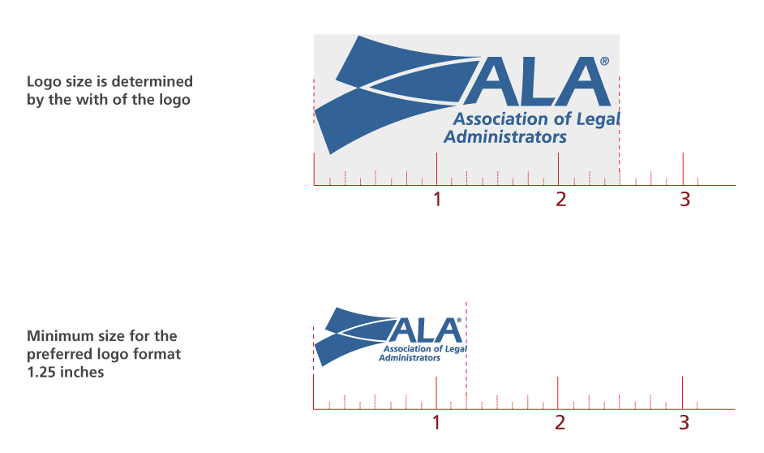
Notes:
For a cohesive look among high-visibility print applications, our logo should be consistently sized from one application to the next. The logo size is determined by measuring the width of the logo. Sizes less than 1.25 inches wide for our preferred logo and 2.25 inches wide for our alternative logo should never be used. This is the smallest size recommended for clear logo reproduction.
More rules and guidelines can be found in the Identity Standards Guidelines.

Slide 17
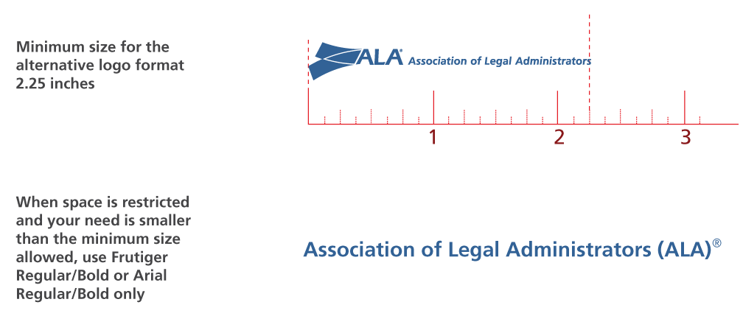

Slide 18
The logo has taken on several different colors and shapes.

Slide 19
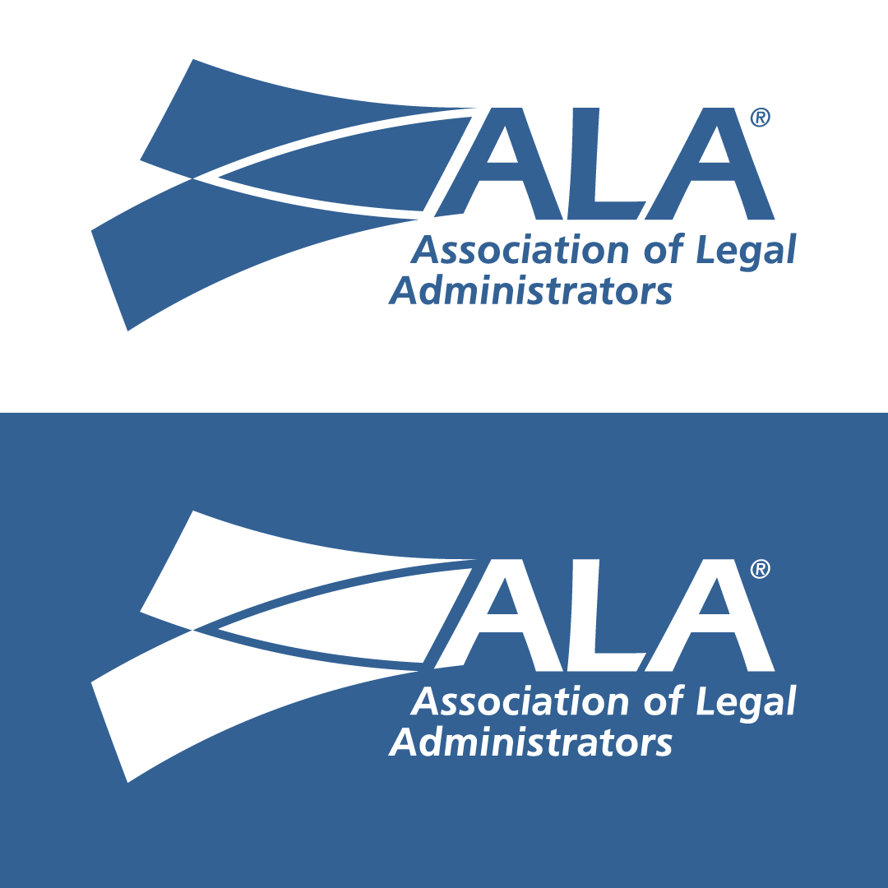
Notes:
The burgundy is fading as are the red and green. If you are up for making changes, stick to the blue in this scene.

Slide 20
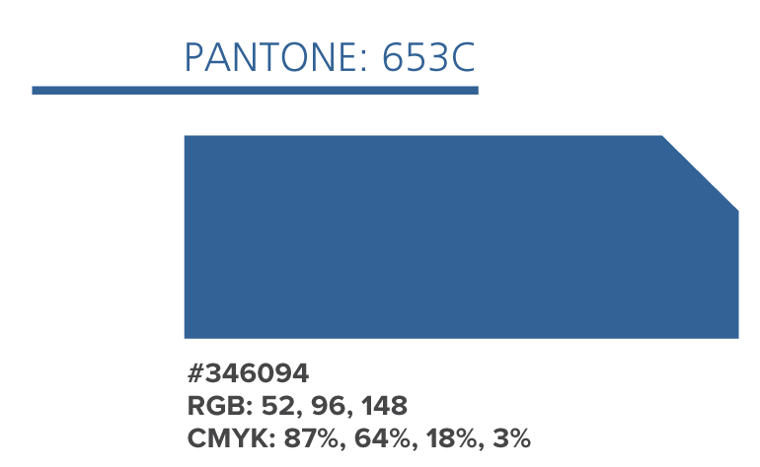
Notes:
The burgundy is fading as are the red and green. If you are up for making changes, stick to the blue in this scene.

Slide 21
Chapters wishing to use the ALA logo on items other than letterhead or envelopes (e.g., clothing, jewelry, plaques, pen sets, coffee mugs, etc.) should contact ALA headquarters to obtain permission for use of the logo.
Based on advice of ALA legal counsel, chapters wishing to use the ALA logo for chapter websites may be required to enter into a License Agreement with ALA, the owner of the logo.
Notes:
The same goes for business partners and other entities.
Chapters should contact ALA headquarters at chapters@alanet.org to obtain permission for use of the logo and to determine if a written agreement is required.

Slide 22
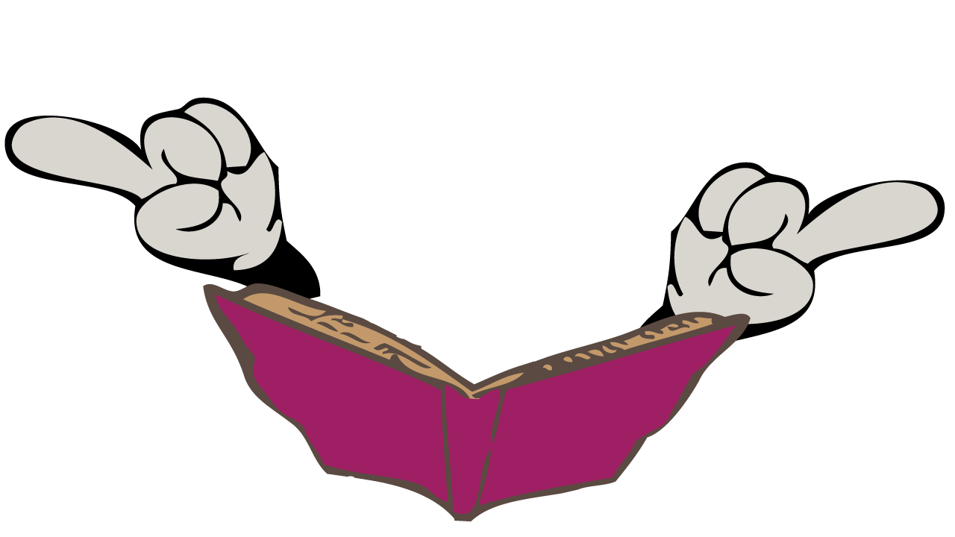
Now that I’ve taught you a thing or two, I’d like to leave you with some words, a few.

Slide 23
Today you are ALA,
that is truer than true.
There is no one alive
who is ALA-er than You.

